Slide 1
Structure Programming
ICT-1105
Information and Communication Technology
Lecture-15
Date:

Slide 2
Class contents has given in Google Classroom with code
nhauiw4

Slide 3
Functions

Slide 4
Parameters
Parameters provides the data communication between the calling function and called function.
They are two types of parameters.
1 : Actual parameters.
2 : Formal parameters.

Slide 5
Parameters
Actual Parameters : These are the parameters transferred from the calling function (main program) to the called function (function).
Formal Parameters :These are the parameters transferred into the calling function (main program) from the called function(function).
The parameters specified in calling function are said to be Actual Parameters.
The parameters declared in called function are said to be Formal Parameters.
The value of actual parameters is always copied into formal parameters.

Slide 6
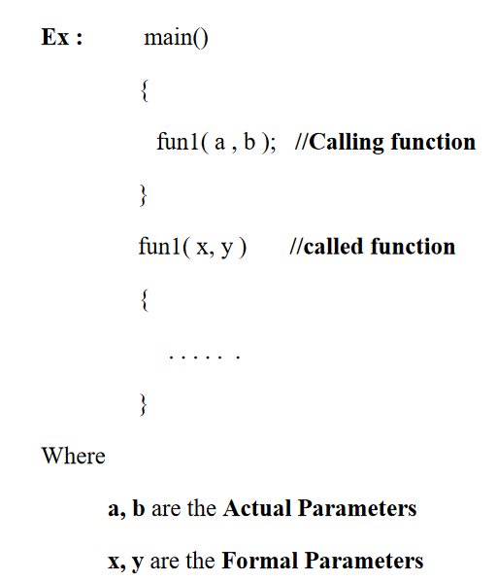
Parameters

Slide 7
Difference between Actual Parameters and Formal Parameters
Actual Parameters | Formal Parameters
1 : Actual parameters are used in calling function when a function is invoked. Ex : c=add(a,b); Here a,b are actual parameters. | 1 : Formal parameters are used in the function header of a called function. Ex : int add(int m,int n); Here m,n are called formal parameters.
2 : Actual parameters can be constants, variables or expression. Ex : c=add(a,b) //variable c=add(a+5,b); //expression. c=add(10,20); //constants. | 2 : Formal parametes should be only variable. Expression and constants are not allowed. Ex : int add(int m,n); //CORRECT int add(int m+n,int n) //WRONG int add(int m,10); //WRONG

Slide 8
Difference between Actual Parameters and Formal Parameters
Actual Parameters | Formal Parameters
3 : Actual parameters sends values to the formal parameters. Ex : c=add(4,5); | 3 : Formal parameters receive values from the actual parameters. Ex : int add(int m,int n); Here m will have the value 4 and n will have the value 5.
4 : Address of actual parameters can be sent to formal parameters | 4 : if formal parameters contains address, they should be declared as pointers.

Slide 9
Passing parameters to functions
There are two ways to pass value or data to function in C language: call by value and call by reference.
Original value is not modified in call by value but it is modified in call by reference.

Slide 10
Passing parameters to functions
The called function receives the information from the calling function through the parameters.
The variables used while invoking the calling function are called actual parameters and the variables used in the function header of the called function are called formal parameters.
C provides two mechanisms to pass parameters to a function.
1 : Pass by value (OR) Call by value.
2 : Pass by reference (OR) Call by Reference

Slide 11
Pass by value (OR) Call by value
In call by value, value being passed to the function is locally stored by the function parameter in stack memory location. If you change the value of function parameter, it is changed for the current function only. It will not change the value of variable inside the caller method such as main().
Or

Slide 12
Pass by value (OR) Call by value
When a function is called with actual parameters, the values of actual parameters are copied into formal parameters. If the values of the formal parametes changes in the function, the values of the actual parameters are not changed. This way of passing parameters is called pass by value or call by value.

Slide 13
Call by value -Example
#include<stdio.h>
void swap(int ,int );
void main()
{
int i,j;
printf("Enter i and j values:");
scanf("%d%d",&i,&j);
printf("Before swapping:%d%d\n",i,j);
swap(i,j);
printf("After swapping:%d%d\n",i,j);
getch();
}

Slide 14
Call by value -Example
void swap(int a,int b)
{
int temp;
temp=a;
a=b;
b=temp;
}
Output:

Slide 15
Pass by reference (OR) Call by Reference
In pass by reference, a function is called with addresses of actual parameters. In the function header, the formal parameters receive the addresses of actual parameters.
Now the formal parameters do not contain values, instead they contain addresses. Any variable if it contains an address, it is called a pointer variable. Using pointer variables, the values of the actual parameters can be changed. This way of passing parameters is called call by reference or pass by reference.

Slide 16
Call by Reference-Example
#include<stdio.h>
void swap(int *,int *);
void main()
{
int i,j;
printf("Enter i and j values:");
scanf("%d%d",&i,&j);
printf("Before swapping:%d%d\n",i,j);
swap(&i ,&j);
printf("After swapping:%d%d\n",i,j);
}

Slide 17
Call by Reference-Example
void swap(int *a,int *b)
{
int temp;
temp=*a;
*a=*b;
*b=temp;
}

Slide 18
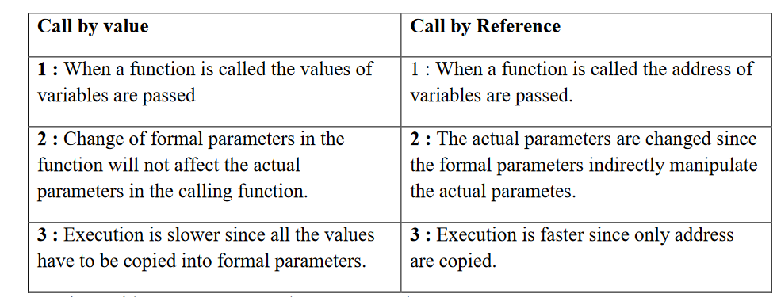
Differnce between Call by value and Call by reference

Slide 19
Functions Categories
There are four main categories of the functions these are as follows:
1. Function with no arguments and no return values.
2. Function with no arguments and a return value.
3. Function with arguments and no return values.
4. Function with arguments and return values

Slide 20
1 : Functions with no parameters/arguments and no return values
In this category, there is no data transfer between the calling function and called function.
But there is flow of control from calling function to the called function.
When no parameters are there , the function cannot receive any value from the calling function.
When the function does not return a value, the calling function cannot receive any value from the called function.

Slide 21
1 : Functions with no parameters/arguments and no return values
syntax:
void funct (void);
main ( )
{
funct ( );
}
void funct ( void );
{
}
NOTE: There is no communication between calling and called function. Functions are executed independently, they read data & print result in same block.

Slide 22
1 : Functions with no parameters/arguments and no return values - Example
#include<stdio.h>
void sum();
void main()
{
sum();
getch();
}
void sum()
{
int a,b,c;
printf("enter the values of a and b");
scanf("%d%d",&a,&b);
c=a+b;
printf("sum=%d",c);
}

Slide 23
2: Functions with no Parameters and Return Values
In this category, there is no data transfer between the calling function and called function.
But there is data transfer from called function to the calling function.
When no parameters are there , the function cannot receive any values from the calling function.
When the function returns a value, the calling function receives one value from the called function.

Slide 24
2: Functions with no Parameters and Return Values
In this category, there is no data transfer between the calling function and called function.
But there is data transfer from called function to the calling function.
When no parameters are there , the function cannot receive any values from the calling function.
When the function returns a value, the calling function receives one value from the called function.

Slide 25
2: Functions with no Parameters and Return Values
Example:
int msg (void) ;
int main ( )
{
int s = msg ( );
printf( “summation = %d” , s);
}
int msg ( void )
{
int a, b, sum ;
sum = a+b ;
return (sum) ;
}
NOTE: Here called function is independent, it read the value from the keyboard, initialize and return a value .Both calling and called function are partly communicated with each other

Slide 26
2: Functions with no Parameters and Return Values
Example:
#include<stdio.h>
int sum();
void main()
{
int c;
clrscr();
c=sum();
printf("sum=%d",c);
getch();
}
i

Slide 27
3: Functions with Parameters and no Return Values
In this category, there is data transfer from the calling function to the called function using parameters.
But there is no data transfer from called function to the calling function.
When parameters are there , the function can receive any values from the calling function.
When the function does not return a value, the calling function cannot receive any value from the called function.

Slide 28
3: Functions with Parameters and no Return Values_Example
#include<stdio.
void sum(int a,int b);
void main()
{
int m,n;
printf("Enter m and n values:");
scanf("%d%d",&m,&n);
sum(m,n);
getch();
}

Slide 29
3: Functions with Parameters and no Return Values_Example
void sum(int a,int b)
{
int c;
c=a+b;
printf("sum=%d",c);
}

Slide 30
4: Functions with Parameters and Return Values
In this category, there is data transfer from the calling function to the called function using parameters.
But there is no data transfer from called function to the calling function.
When parameters are there , the function can receive any values from the calling function.
When the function returns a value, the calling function receive a value from the called function.

Slide 31
4: Functions with Parameters and Return Values-Example
#include<stdio.h>
int sum(int a,int b);
void main()
{
int m,n,c;
printf("Enter m and n values");
scanf("%d%d",&m,&n);
c=sum(m,n);
printf("sum=%d",c);
getch();
}

Slide 32
4: Functions with Parameters and Return Values-Example
int sum(int a,int b)
{
int c;
c=a+b;
return c;
}

Slide 33
Thank you….

